Slide 1
ELISA Technique
Author
Institutional Affiliation
Instructor
Course code
Date of submission

Slide 2
Introduction
ELISA (Enzyme-linked immunosorbent assay) represents an essential technique used to detect and quantify soluble proteins in complex mixtures (Lequin, 2005).
The technique was originally advanced by Engvall and Perlmann in 1971 as a crucial method of analyzing protein samples immobilized in microplate wells using specific antibodies (Engvall, E., & Perlmann, 1971).
ELISA techniques are generally performed in either 96-well or 384-well polystyrene plates. This is because the plates can passively bind the antibodies and proteins.
Arguably, it is due to the immobilization and the binding of the reagents that make the technique easy to design and even perform.

Slide 3
ELISA technique is an enzyme-linked immunosorbent assay that is specifically designed to detect the presence of soluble substances such as peptides, proteins and hormones (Lequin, 2005).
Similarly, the technique also quantifies the soluble substances. It is essential to understand that the same technique is sometimes referred to as enzyme immune assay.
In an ELISA, the antigen (target macromolecule) is immobilized on a solid surface (microplate) and then complexed with an antibody that is linked to a reporter enzyme.
In this sense, to accomplish detection, ELISA measures the activity of the reporter enzyme through incubation with the appropriate substrate to produce a product that can be measured.

Slide 4
Essentially, the reactants of an ELISA are immobilized to the microplate surfaces because believably, this presents an easy strategy to separate bound from non-bound material during an assay.
Observably, the most important aspect in ELISA is a highly specific antibody-antigen interaction.

Slide 5
Basic Principles of ELISA
ELISA uses an enzyme to detect the binding of antigen (Ag) antibody (Ab).
During a detection assay, the enzyme converts a colourless substrate to a coloured product; this indicates the presence of Ag: Ab binding (Voller et al. 1979).
ELISA tests can be performed to detect the presence of antigens and antibodies in a sample depending on how the test is designed.
ELISA is referred to as a wet-lab type of assay that uses a solid surface to detect the presence of antigens in liquid or wet samples. In this sense, ELISA involves the quantitative and qualitative analysis of the virus (Kinman, 2018).
The process of antigen detection in an ELISA is accomplished by assessing the conjugated enzyme activity via incubation with a substrate which consequently forms a coloured product.

Slide 6
Most importantly, the technique's ability to use high-affinity antibodies to particularly wash away non-specific bound materials makes it an essential tool to measure specific analytes within a crude mixture.
Observably, most ELISA assays use enzymes such as horseradish peroxidase (HRP) and alkaline phosphatase (AP).
However, even though these represent the most commonly used enzymes, it is essential to understand that some other enzymes are also used such as β-galactosidase, acetylcholinesterase, and catalase.

Slide 7
ELISA Formats
ELISA is presented in various formats some of which include; direct, indirect, sandwich, capture and detection.
However, the most critical step in this technique is the immobilization of the specific antigen, this is usually accomplished by either direct absorption to the assay plate or indirectly through the capture antibody attached to the plate (Zhang et al., 2018).
The next step is detection where the antigen is detected either directly or indirectly. Direct detection is labelled as primary antibody whereas indirect detection is labelled as a secondary antibody.
Generally, sandwich remains the most applicable ELISA assay format, this involves an indirect immobilization and indirect detection of the presence of the target antigen.

Slide 8
It is referred to as sandwich because the analyte to be measured is captured between two primary antibodies with each of them detecting a different aspect of the antigen.
In essence, because of its high sensitivity and specificity, the ELISA sandwich is highly used.

Slide 9
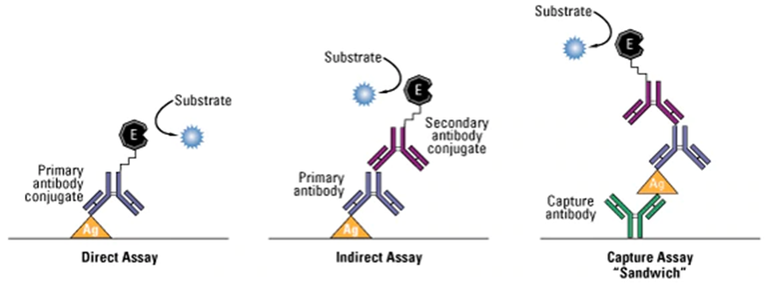
An image showing common ELISA formats including indirect, direct and sandwich ELISA methods.

Slide 10
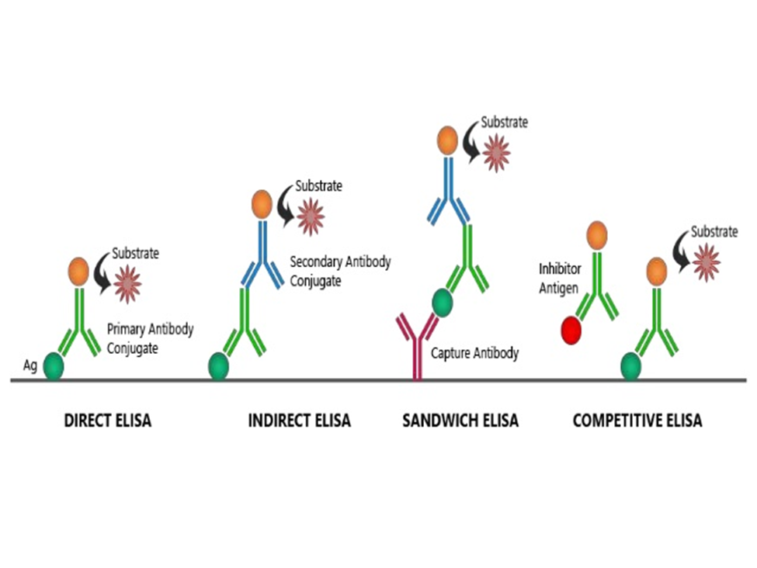
An Image showing Different types of ELIAS

Slide 11
Direct versus Indirect ELISA detection methods
In an ELISA, the direct method uses a primary antibody labelled with a reporter enzyme or a tag that reacts directly with the antigen.
Notably, Direct detection can be performed either with a directly immobilized antigen on the assay plate or with a capture assay format (Asensio et al., 2008).
Although this is not a common strategy used in ELISA assays, direct detection is used in immunohistochemical staining of tissues and cells.
On the other hand, the indirect detection strategy uses a labelled secondary antibody. In some other circumstances, the method can use a biotin-streptavidin complex for amplification.

Slide 12
In this strategy, the secondary has specificity for the primary antibody.
It is important to note that in a sandwich ELISA, for the detection of the primary antibody, the secondary antibody must be specific.
Generally, sandwich ELISA requires the use of secondary antibodies that have been cross-adsorbed, an idea that targets the removal of any secondary antibodies that might have an affinity for the capture antibody.

Slide 13
Advantages of direct ELISA strategy
Observably, direct ELISA is recommended because it involves very few steps and only one antibody is used in the detection. Similarly, the cross-reactivity of the secondary antibody is limited.

Slide 14
Disadvantages
The labelling of the reporter enzymes may adversely affect the immune reactivity of the primary antibody.
Also, the process observably requires a lot of time to have all the primary antibodies properly labelled.
Besides being costly, there exists a limited number of conjugated antibodies available commercially.
For these reasons, there is limited flexibility in the choice of primary antibodies.

Slide 15
Advantages of Indirect ELISA detection
In contrast to the direct strategy, there exists a wide variety of secondary antibodies for this strategy.
These antibodies are available commercially.
Also, in this strategy, there is a maximum immune reactivity of the primary antibody is retained because it is not labelled.
The strategy also involves different detection methods that can be used with the same primary antibody during the detection process.

Slide 16
Disadvantages
Cross-reactivity might occur with the secondary antibody, resulting in nonspecific signal.
An extra incubation step is required in the procedure.

Slide 17
Sandwich ELISA
The strategy presents high sensitivity and high specificity for the target antigens, this is because two antibodies are utilized in the capture and detection.
Observably, with the same capture antibody, different detection methods can be used.

Slide 18
Disadvantages
Arguably, the strategy would require more optimization to particularly identify antibody pairs and ensure there is limited cross-reactivity between the capture and detection antibodies.

Slide 19
Competitive ELISA
In this test, the test antibodies are first incubated in a solution containing a sample. The strategy is commonly used when the antigen is small and only has one epitope.

Slide 20
ELISA plates
When designing an ELISA for a specific antigen, it is important to optimize the plate-coating conditions for the antigen (Shah & Maghsoudlou, 2016).
An assay microplate with a minimum protein-binding capacity of 400 ng/cm2. Plates are chosen depending on the signal being detected.
Clear polystyrene plates are used in detecting coli metric signals while black polystyrene is used in fluorescent and chemiluminescent signal detections.
Passive adsorption of the protein ensures the achievement of plate coating to the plastic of the assay microplate.

Slide 21
Although individual proteins may require specific conditions or pretreatment for optimal binding, the most common method for coating plates involves adding a 2–10 μg/ml solution of protein dissolved in an alkaline buffer such as phosphate-buffered saline (pH 7.4) or carbonate-bicarbonate buffer (pH 9.4) (Davies, 2020).
The plates are then left to incubate for some time with average temperatures between 4 degrees and 37 degrees.
Usually, after removing the coating solution, blocking buffers are added to particularly ensure that all the binding surfaces of the plastic are well covered.

Slide 22
Primary antibodies for ELISA
In an ELISA, either monoclonal or polyclonal antibodies can be used in the capture and detection of the antigen.
Monoclonal antibodies have inherent monospecificity toward a single epitope that allows fine detection and quantitation of small differences in antigen (Crowther, 2009).
Similarly, for improved specificity, monoclonal antibodies are used in the detection. Also, polyclonal antibodies are usually used as capture antibodies to pull down as much of the antigen as possible.
Besides monoclonal and polyclonal antibodies, recombinant antibodies are also used because they are not susceptible to cell-line drift or lot-to-lot variation, thus allowing for peak antigen specificity.

Slide 23
Blocking buffers and wash buffers
It is important to note that the binding capacity of the microplate wells is usually higher than the protein-coated in each well, for this reason, there is need to block surface area to particularly prevent the adsorption of antibodies to the plates during the detection process. In this sense, the buffer solution passively adsorbs all the remaining surfaces of the microplate.
Believably, this presents effective results since it significantly improves the sensitivity of an assay by reducing the background signal detection.
Besides blocking, it is important to perform washes, which is essential in removing non-bound reagents and decreases the background. while excessive washing might result in decreased sensitivity caused by elution of the antibody and/or antigen from the well.

Slide 24
Detection strategies in ELISA
The last stage in an ELISA is the detection step which in most situations involves the addition of an enzyme-substrate unless a radioactive tag was used during the detection process.
Ideally, the essence of enzyme addition is that it converts the substrate into a detectable product. It is worth noting that if an ELISA has been constructed and developed properly, then the intensity of signal produced when the substrate is added will be directly proportional to the amount of antigen captured in the plate and bound by the detection reagents (Butler, 1992).

Slide 25
Applications of ELISA
Monoclonal antibody testing
Virus tests such as HIV, NDV and West Nile virus
Home pregnancy kit
The food industry in the detection of certain allergens in foods such as milk, eggs and walnuts
Studying drug toxicity

Slide 26
ELISA data interpretation
Quantitative
ELISA data can be interpreted in comparison to a standard curve (a serial dilution of a known, purified antigen) to precisely calculate the concentrations of antigen in various samples.
Qualitative
ELISA experiments can be used to determine the presence or absence of a certain antigen in a particular sample. The data is usually compared to a blank well containing no specific antigen or just an unrelated control antigen.

Slide 27
Semi-quantitative
ELISAs can be used in comparing the relative levels antigen in an assay sample. This is because the intensity of an ELISA will be directly correlated with the concentration of the antigens.

Slide 28
References
Voller, A., Bidwell, D. E., & Bartlett, A. (1979). The enzyme-linked immunosorbent assay (ELISA). A guide with abstracts of microplate applications. Dynatech Europe, Borough House, Rue du Pre...
Lequin, R. M. (2005). Enzyme immunoassay (EIA)/enzyme-linked immunosorbent assay (ELISA). Clinical chemistry, 51(12), 2415-2418.
Asensio, L., González, I., García, T., & Martín, R. (2008). Determination of food authenticity by enzyme-linked immunosorbent assay (ELISA). Food control, 19(1), 1-8.
Zhang, L., Li, H. Y., Li, W., Shen, Z. Y., Wang, Y. D., Ji, S. R., & Wu, Y. (2018). An ELISA assay for quantifying monomeric C-reactive protein in plasma. Frontiers in immunology, 9, 511.

Slide 29
Shah, K., & Maghsoudlou, P. (2016). Enzyme-linked immunosorbent assay (ELISA): the basics. British journal of hospital medicine, 77(7), C98-C101.
Kinman, T. (2018). ELISA. Retrieved from: https://www.healthline.com/health/elisa#procedure
Davies, C. P. (2020). ELISA Tests. Retrieved from: https://www.medicinenet.com/elisa_tests/article.htm
Crowther, R. J. (2009). The ELISA Guidebook. ed.
Butler, J. E. (1992). The behaviour of antigens and antibodies immobilized on a solid phase. Structure of antigens, 1, 208-259.
Engvall, E., & Perlmann, P. (1971). Enzyme-linked immunosorbent assay (ELISA) quantitative assay of immunoglobulin G. Immunochemistry, 8(9), 871-874.
Lequin, R. M. (2005). Enzyme immunoassay (EIA)/enzyme-linked immunosorbent assay (ELISA). Clinical chemistry, 51(12), 2415-2418.

